Slide 1
Estimated Price of Shallots Commodities National Based on Parametric and Nonparametric Approaches
Presenter : Nurul Afifah
Corresponding Author : M. Fariz Fadillah Mardianto
Department of Mathematics, Airlangga University, Surabaya, Indonesia
Co Authors : Siti Amelia Dewi Safitri, Idrus Syahzaqi, Sediono

Slide 2


INTRODUCTION
The trade sector for agricultural commodities, livestock, fisheries and horticulture is important for an agrarian and maritime country like Indonesia.
This urgency is needed to maintain and improve food security, economic and trade stability.
In 2018, agricultural commodities are one of the commodities that had the highest contribution with the achievement of GDP increased from 10.96% to 11.42% in 2019 (Badan Pusat Statistik, 2019).

Slide 3




INTRODUCTION
Shallots are one of the leading commodities that strengthen national food security.
These commodities contribute to the improvement of the economies of the producing regions.

Slide 4

INTRODUCTION
The increase in commodity prices has an impact on inflation
The fluctuating commodity prices cause various impacts
The prediction results are useful in evaluating government policies related to national food security
Prediction

Slide 5
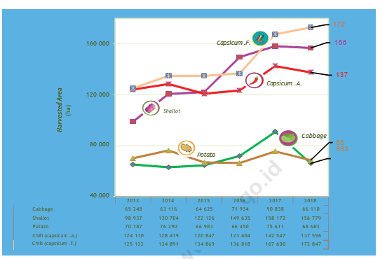
INTRODUCTION
.
Production of Main Seasonal Vegetables in 2013 - 2018 (Ton) (Badan Pusat Statistik, 2019)

Slide 6
INTRODUCTION
In predicting the price of shallots commodities, statistical modeling is carried out using parametric and nonparametric approaches based on kernel and Fourier series estimators.
.
 | Advantage | Disadvantage
Parametric Approach | Parsimony and easy to interpret | Requires assumptions that are stationary, the residuals are normally distributed and the variance is constant
Nonparametric Approach Kernel estimator Fourier series estimator | Had a flexible form and its mathematical calculations were easily adjusted Has the property of flexibility in approaching repeating or oscillating data patterns according to the pattern of trigonometric functions

Slide 7
INTRODUCTION
The best estimator is the smallest Generalized Cross Validation (GCV) estimator for the bandwidth of the kernel estimator or the oscillation parameter of the Fourier series estimator.

Slide 8
METHODS Autoregressive Integrated Moving Average (ARIMA)
Model consisting of a combination of Autoregressive (AR) and Moving Average (MA) (Mardianto et. al. , 2019).
.

Slide 9
METHODS Nonparametric Regression
Nonparametric regression is a method used to determine the pattern of relationships between response variables and predictors in which the relationship patterns between the two cannot be clearly identified (Wei, 2006).
Kernel estimator has a flexible form and mathematical calculations that can be adjusted to the characteristics of the data (Eubank, 1999).
Fourier series is trigonometric polynomial functions that have a high degree of flexibility. The advantage of Fourier series is that it can overcome data patterns based on the trigonometric pattern approach (Hardle, 1990).
.

Slide 10
METHODS The Performance Indicator
There are three indicators that are often used in nonparametric regression research in determining the best model (Eubank, 1999).
1. Generalized Cross Validation (GCV)
➔ Determine the optimum oscillation parameters (k)
2. Mean Square Error (MSE)
3. The Coefficient of Determination (R²)
➔ Determine the contribution of predictor variables to the response variable
The best model is chosen based on the minimum value on the MSE, GCV, and the maximum value on the value of R²

Slide 11
THE DATA
Variables
Shallots prices every week in Indonesia with 183 observations from August 2016 to January 2020
Training Data
First week of August 2016 to fourth week of December 2019
Testing Data
Fifth week of December 2019 to fourth week of January 2020
Pusat Informasi Harga Pangan Strategis (PIHPS)

Slide 12
THE DATA
Scatter Plot of Weekly Shallots Commodity Prices in Indonesia

Slide 13
RESULT AND DISCUSSION
Parametric Estimation based on ARIMA
The stationary with Augmented Dicky Fuller test shows that P-Value is 0,000 which means less than alpha (5%). So, data has been stationary.
Test Statistic | t value | P-Value
Augmented Dickey-Fuller | -5,93352 | 0.000

Slide 14
RESULT AND DISCUSSION
Model | White Noise | MSE | Significance
ARIMA (1,1,0) | Failed to meet assumption | 0,000585 | AR (1) = 0,000
ARIMA (2,1,0) | Failed to meet assumption | 0,0005617 | AR (1) = 0,000 AR (2) = 0,005
ARIMA (0,1,1) | Failed to meet assumption | 0,000707 | MA (1) = 0,000
ARIMA (0,1,2) | Failed to meet assumption | 0,000612 | MA (1) = 0,000 MA (2) = 0,000
ARIMA (1,1,1) | Failed to meet assumption | 0,0005610 | AR (1) = 0,000 MA (1) = 0,002
Based on table, ARIMA (1,1,1) was selected with the smallest MSE is 0,0005610. However, ARIMA model which was selected and all of models did not meet the white noise assumption.

Slide 15
RESULT AND DISCUSSION
Nonparametric Estimation Based On Kernel
Nonparametric Estimation Based On Fourier Series
Bandwidth | GCV
0,545 | 207.771,4
0,555 | 207.665,9
0,565 | 207.769,4
Oscillation Parameters | GCV
37 | 4.891.342
38 | 4.772.656
39 | 12.229.037
The smallest GCV value is 207.665,9 and the optimum bandwidth is 0,555. In the kernel estimator model can follow the actual pattern closely with MSE value is 757,7224 and R² is 99,95%.
The minimum GCV value is 4.772.656 and the oscillation parameter is 38. In the Fourier series estimator model can follow the actual pattern closely with MSE value is 2.646,848 and R² is 79,96%.

Slide 16
RESULT AND DISCUSSION
Comparison To Select The Best Estimator
Estimation | Information | Mean Square Error
Parametric | ARIMA (1,1,1) (white noise was not satisfied) | 0,0005610
Kernel Gaussian | Optimum Bandwidth: 0,555 | 757,7224
Fourier series | Oscillation Parameter: 38 | 2.646,848
The nonparametric is better than the parametric approach. It was seen from the smaller MSE value, the lack of the parametric approach using ARIMA (1,1,1) also meet the white noise was not satisfied.

Slide 17
RESULT AND DISCUSSION
Comparison Nonparametric Regression Estimator
Estimation | Information | MSE | GCV | R²
Kernel Gaussian | Optimum Bandwidth: 0,555 | 757,7224 | 207.665,9 | 99,95%
Fourier series Sin and Cos | Oscillation Parameter: 38 | 2.646,848 | 4.772.656 | 79,96%
Based on Table, it showed that MSE and R2 values in the Gaussian kernel estimator were better than Fourier series with MSE values is 757,7224 and R² is 99,95%. It means that Gaussian kernel estimator is very suitable to be used in modelling the price of shallots commodities in Indonesia.

Slide 18
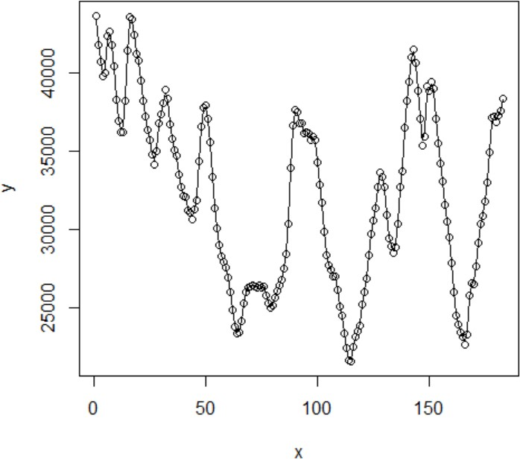
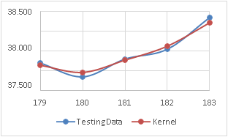
RESULT AND DISCUSSION
Kernel Estimator
Based plot testing data with kernel estimator, it can be seen that prediction results using testing data with kernel estimator do not have a big difference with testing data. In addition, the prediction result has a small Mean Absolute Percentage Error (MAPE) value of 1,088%. Thus, the kernel estimator is suitable in estimation the national price of shallots.
Kernel Estimator Plot Results
According to kernel estimators plot results, it can be seen that the estimation results are the same and so that the curve has flexibility in modelling the relationship between variables, the regression curve follows the data pattern.
Plot Testing Data with Kernel Estimator

Slide 19
CONCLUSIONS
1
The prediction of shallots prices in Indonesia can be done with the parametric and nonparametric approaches. However, in this research the parametric approach did not satisfy the assumption of white noise.
2
We choose kernel estimator, because the estimator has satisfied the parsimony model, the smallest GCV value and MSE value, and the biggest determination coefficient where the results are better than Fourier series
3
With this prediction, the government can make policies such as determining standard selling price of shallots and determining the price standard is carried out for maintaining price stability, so as to maintain and increase food security, economic stability, and trade.
4
For prediction the shallots prices, the kernel estimator has good performance with small MAPE value is 1,088%.

Slide 20
THANK YOU

